Slide 1
Children’s Medicaid Waivers & More
www.familyvoicesco.org (303) 877-1747 info@familyvoicesco.org

Slide 2
Caregiver Conversations
Webinars on the first Thursday of every month.
7:00 PM-8:30 PM
We know your time is precious we and are committed to providing information in a specific timeline.
Our timeline:
7:00-7:10 Intros and Overview
7:10-8:00 Information
8:00-8:30 Questions/Answers
NOTE: Please do not share private health information, as we are recording this webinar. If you have questions that are of a more private nature, one of our staff will connect with you, at another time.

Slide 3
Family Voices Overview
Family Led Nonprofit
Provide:
Systems Navigation
Education and Training
Advocacy and Policy
F2F Health Information Center
Affiliate of Family Voices national organization
https://www.familyvoicesco.org/
(855) 877-1747
info@familyvoicesco.org

Slide 4
Ways for Children to Access Medicaid in Colorado
Income Based (SSI or MAGI Medicaid)
Family income and assets requirements
No disability requirements
Medicaid Buy-in
Family Income requirements
Disability as determined by Social Security Administration (SSA)
Medicaid Waivers
*Child’s* income and asset requirements
Disability per SSA
Functional Criteria (100.2)
Waiver Specific targeting criteria
Adoption Agreement
www.familyvoicesco.org (303) 877-1747 info@familyvoicesco.org

Slide 5
HCBS Waiver - Eligibility
Citizenship and Residency
Citizen of the United States or a qualified non-citizen
Resident of Colorado
Disability
Social Security Administration definition of disability
www.familyvoicesco.org (303) 877-1747 info@familyvoicesco.org

Slide 6
HCBS Waiver - Eligibility
Functional Criteria for Long Term Supports and Services (LTSS)
Long Term Care 100.2 Assessment:
Bathing
Dressing
Toileting
Eating
Mobility
Transferring
Supervision Cognitive/Memory
Supervision Behavioral
Abilities are scored from 0-3. Child required to score a score of “2” in at least two ADL areas or a score of “2” in at least one of the Supervision areas.
www.familyvoicesco.org (303) 877-1747 info@familyvoicesco.org

Slide 7
HCBS Waiver - Eligibility
Financial Criteria
The child's income must be less than $2,742 a month in 2023 (300%, or three times, the Supplemental Security Income allowance)
The child’s countable resources (assets) less than $2,000
Targeting Criteria
Different for each Waiver program based on purpose for each Waiver
www.familyvoicesco.org (303) 877-1747 info@familyvoicesco.org

Slide 8
4 Children’s HCBS Waivers
“Medical” Waivers
CHCBS (Children’s Home & Community Based Services)
CLLI Children with Life Limiting Illness)
“Developmental” Waivers
CES (Children’s Extensive Support)
CHRP (Children’s Habilitation Residential Program)
Must renew eligibility for waiver annually
Must use a waiver service at least once every 30 days to stay on waiver
www.familyvoicesco.org (303) 877-1747 info@familyvoicesco.org

Slide 9
CHCBS – Children’s Home & Community Based Services Waiver
Who is served?
Children birth to 18 years
Children must meet a skilled nursing level of care
Children who are not eligible for income based Medicaid
Targeting Criteria
Children who have intensive and high cost medical needs
www.familyvoicesco.org (303) 877-1747 info@familyvoicesco.org

Slide 10
CHCBS Waiver Services
Case Management
In Home Support Services (IHSS) for Health Maintenance Activities (HMA)
Assistance with skilled health-related activities that are typically provided by a certified or licensed attendant, such as a CNA, LPN or RN
Family members, including parents, may provide this care
Evaluation for hours provided by case management agency
www.familyvoicesco.org (303) 877-1747 info@familyvoicesco.org

Slide 11
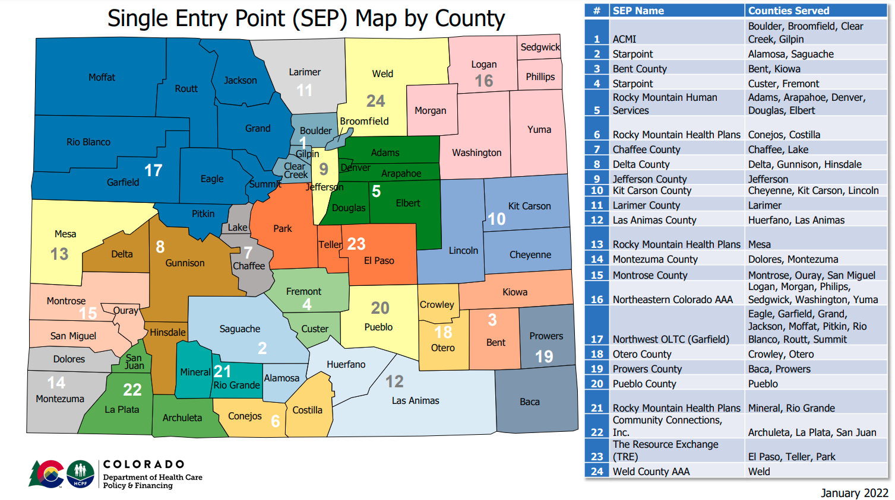
Where to apply?
Single Entry Point or Private Case Management Agencies
www.familyvoicesco.org (303) 877-1747 info@familyvoicesco.org

Slide 12
CLLI – Children with Life Limiting Illness
Who is served?
Children birth to 19 years
Child must meet a hospital level of care
Targeting Criteria
Children who have a life limiting diagnosis (i.e based on opinion of medical specialist, that child has a prognosis of death without medical intervention before the child reaches adulthood)
www.familyvoicesco.org (303) 877-1747 info@familyvoicesco.org

Slide 13
CLLI Waiver Services
Expressive Therapy - Art and Play Therapy, Music Therapy
Massage Therapy
Palliative/Supportive Care: - Care Coordination, Pain and Symptom Management
Respite Care
Therapeutic Services - Bereavement Counseling, Individual/Family/Group Counseling
Must be able to justify the need for each service
www.familyvoicesco.org (303) 877-1747 info@familyvoicesco.org

Slide 14
Where to apply?
Single Entry Point or Private Case Management Agencies
www.familyvoicesco.org (303) 877-1747 info@familyvoicesco.org

Slide 15
CES – Children’s Extensive Support Waiver
Who is served?
Children birth to 18 years
Children who are at risk of institutionalization and meet Intermediate Care Facility level of need
Children birth to age 5 must have a developmental delay, Children 5-17 must have a developmental disability
Targeting Criteria
Demonstrate a medical or behavioral condition that is so intense that almost constant line of sight supervision is required to keep the child and others safe
Child must have medical condition or serious behavioral condition which requires a direct physical intervention every 2 hours during the day and every 3 hours during the night
www.familyvoicesco.org (303) 877-1747 info@familyvoicesco.org

Slide 16
CES Waiver Services
Respite
Community Connector
Homemaker (basic and enhanced)
Home/Vehicle Accessibility Adaptations
Specialized Medical Supplies & Equipment
Assistive Technology
Adaptive Recreation
Professional Services (Hippo, Music, Massage Therapy)
Parent Education
Must be able to justify the need for each service
The sum of all CES Waiver services utilized must cost less than $53,748.67 per plan year (as of 2023)
CES Services Guide
www.familyvoicesco.org (303) 877-1747 info@familyvoicesco.org

Slide 17
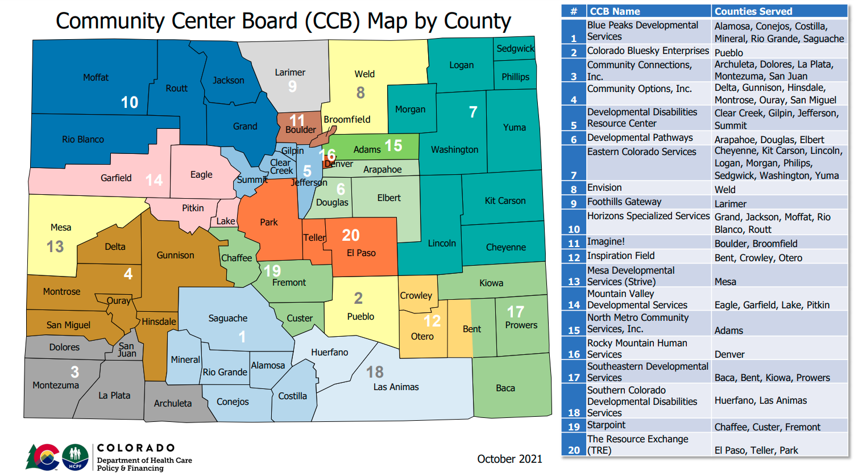
Where to apply?
Community Centered Board
www.familyvoicesco.org (303) 877-1747 info@familyvoicesco.org

Slide 18
CHRP – Children’s Habilitation Residential Program Waiver
Who is served?
Children birth to 21 years
Children birth to age 5 must have a developmental delay, Children 5-17 must have a developmental disability
Children who have extraordinary service needs
Child must meet Intermediate Care Facility level of need
Child has intensive behavioral or medical support needs that put them at risk of out of home placement
www.familyvoicesco.org (303) 877-1747 info@familyvoicesco.org

Slide 19
CHRP Waiver Services
Supported Community Connections
Habilitation Services
Professional Services (Hippotherapy, Massage, Movement Therapy)
Respite Services
Intensive Support Services
Transition Support Services
Must be able to justify the need for each service
www.familyvoicesco.org (303) 877-1747 info@familyvoicesco.org

Slide 20
Where to apply?
Community Centered Board
www.familyvoicesco.org (303) 877-1747 info@familyvoicesco.org

Slide 21
HCBS Waiver Resources
Waiver Flow Chart
Waiver Chart English
Waiver Chart (Spanish)
More…
www.familyvoicesco.org (303) 877-1747 info@familyvoicesco.org

Slide 22
How do I apply?
 | MAGI | SSI | Buy-in | HCBS Waivers
Medicaid Application www.colorado.gov/peak or County Department of Human Services or With assistance from Case Manager | x | x | x | x
Disability Determination County Department of Human Services - Application goes to ARG/Arbor for review or Social Security Administration |  | x | x | x
Level of Care and Waiver Application Community Centered Board or Single Entry Point soon to be… Case Management Agency |  |  |  | x

Slide 23
How do I renew?
 | Programs | Frequency
Medicaid Application www.colorado.gov/peak or County Department of Human Services or With assistance from Case Manager | MAGI, Buy-in, Waivers | Annually
Disability Determination County Department of Human Services - Application goes to ARG/Arbor for review or Social Security Administration | SSI, Buy-in, Waivers | Every 5-7 years
Level of Care and Waiver Application Community Centered Board or Single Entry Point soon to be… Case Management Agency | Waivers | Annually

Slide 24
Which is Right for Me?
Questions to answer
Medical, developmental, or both?
Medical
Qualifies for income based Medicaid?
Life Limiting Diagnosis?
Developmental
IQ or Adaptive skills testing?
Overnight care needs?
At risk of out of home placement?
IHSS or CNA?
www.familyvoicesco.org (303) 877-1747 info@familyvoicesco.org

Slide 25
Paid Family Caregiver Options for Children
CNA or PDN
Must qualify for Long-term Care
Must qualify for skilled care, hours are determined by PAT tool
Family member must obtain their CNA or nursing license
Employed by a home health agency with same requirements as if a non family member provided services
IHSS
Must be on the CHCBS Waiver
Must qualify for skilled care - health maintenance activities (HMA)
CHCBS case manager completes assessment to determine hours
Nurse Practice Act is waived so no licensure is required
Employed by a home health agency
May be provided by family members or outside providers
www.familyvoicesco.org (303) 877-1747 info@familyvoicesco.org

Slide 26
Upcoming Changes
Case Management Redesign
One agency per region to manage all HCBS waivers
“Conflict Free” - case management and direct services can’t be provided by the same agency
Will start 7/2024
https://hcpf.colorado.gov/case-management-redesign
www.familyvoicesco.org (303) 877-1747 info@familyvoicesco.org

Slide 27
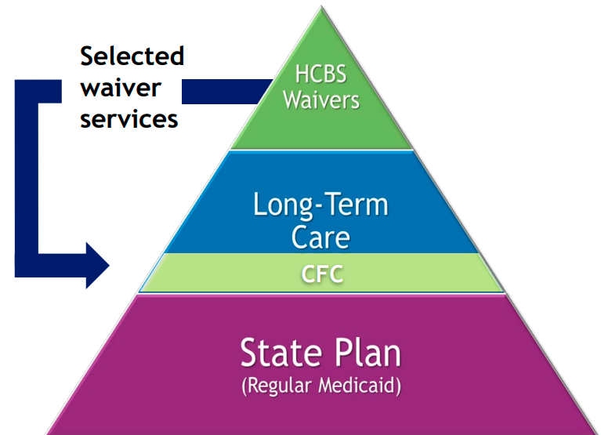
Upcoming Changes cont.
Community First Choice (CFC)
Transition some services from HCBS waivers to be available to any Medicaid member who meets the level of care needs regardless of how they access Medicaid
Services transitioning are still being finalized, the biggest impact will be expansion of IHSS and CDASS
Will start 7/2025
https://hcpf.colorado.gov/community-first-choice-option
www.familyvoicesco.org (303) 877-1747 info@familyvoicesco.org

Slide 28
Upcoming Changes cont.
CHCBS and CLLI Waivers Combining:
Beginning July 2025 at renewal members would transition from either waiver onto the “new waiver”
“New Waiver” will include all CLLI benefits
Members previously on CHCBS will then be able to use benefits that they couldn’t access before (like respite and massage therapy)
Members previously on CLLI should continue to receive all the same benefits just under a different waiver name
www.familyvoicesco.org (303) 877-1747 info@familyvoicesco.org

Slide 29
Questions?
Contact:
Main number (303) 877-1747
Jamie Stefanski - Family Navigator
jamie@familyvoicesco.org
Gaby Diaz - Bilingual Family Navigator
gaby@familyvoicesco.org
Megan Bowser - Deputy Director
megan@familyvoicesco.org
Christy Blakely - Executive Director
christy@familyvoicesco.org
Natasha Archuletta - Administrator
natasha@familyvoicesco.org

Slide 30
Other Assistance
Family Support (FSSP) and/or Mil Levy Funding
Apply through CCB
Funding for “unmet needs”
Must have developmental delay (0-5yrs) or developmental disability (6-18yrs)
Each county runs their programs differently but can provide on average $1,000-$10,000 per year for disability related needs not otherwise covered.
Apply through CCB
www.familyvoicesco.org (303) 877-1747 info@familyvoicesco.org

Slide 31
Other Assistance cont.
HIBI - Health Insurance Buy In Program
Funding towards the child’s portion of their private insurance monthly premium
Designed to encourage families to keep their children on private insurance as primary insurance
https://www.mycohibi.com/
NEMT - Non-emergent Medical Transportation
Assistance with transportation to non emergency visits for Medicaid covered services
Mileage reimbursement for providing your own transportation to the above
Assistance with travel expenses for approved out of state medical appointments
https://www.healthfirstcolorado.com/nemt/
www.familyvoicesco.org (303) 877-1747 info@familyvoicesco.org

