Slide 1
Adult Home and Community Based Service (HCBS)Waivers
www.familyvoicesco.org (303) 877-1747 info@familyvoicesco.org

Slide 2
Family Voices Overview
Family Led Nonprofit
Provide:
Systems Navigation
Education and Training
Advocacy and Policy
F2F Health Information Center
Affiliate of Family Voices national organization
www.familyvoicesco.org/
(303) 877-1747
info@familyvoicesco.org

Slide 3
What is Medicaid? (Health First Colorado)
Medicaid is a federal and state program that provides medical assistance to individuals based on eligibility requirements for technical and financial criteria as defined in the policy.
For every dollar Medicaid pays for healthcare, $0.50 is paid by federal funds and $0.50 is pay by state funds.
No Copays for ages 0-21
No Deductibles
All medically necessary services are covered for ages 0-21 (EPSDT)
Home Healthcare - CNA, PDN, Personal Care
No hard limits on number of therapy visits a year
Medical supplies like diapers, wipes, formula, etc
Durable medical equipment (DME) like wheelchairs, standers, etc

Slide 4
Medicaid - Health First Colorado
Benefits Pyramid
HCBS Waivers
Waivers, participant-directed services, transition services
Long-Term Care
Nursing facility services, home health*, case management
*For children these LTC services can be provided in state plan through EPSDT too
State Plan (Regular Medicaid)
Inpatient and outpatient hospital services, physician services, laboratory and x-ray services, prescription drugs, dental services, and more
www.familyvoicesco.org (303) 877-1747 info@familyvoicesco.org
‹#›

Slide 5
EPSDT
Early and Periodic Screening, Diagnostic, and Treatment
It is a federal mandate. It doesn’t allow hard limits on children (0-21) services.
Provides comprehensive services and furnishes all Medicaid coverable, appropriate, and medically necessary services needed to correct and ameliorate health conditions.
Covers Medicaid Members Ages 0-21
Screening
Vision
Dental
Hearing
Diagnostic
Treatment
Other - Medically Necessary

Slide 6
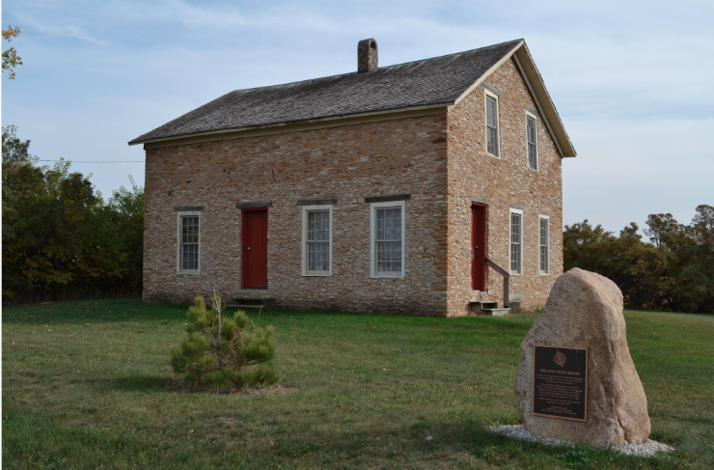
The Medicaid House
There are different ways to get into the Medicaid house
-doors and windows-
MAGI Medicaid
Household income requirements
No disability requirements
SSI Medicaid
Income and assets requirements
Disability as determined by Social Security Administration (SSA)
Medicaid Buy-in for Working Adults
Family income requirements
Disability as defined by SSA
Must be employed
Medicaid HCBS Waivers
*Individual’s* income and asset requirements
Disability as defined by SSA
Functional Criteria (100.2)
Waiver Specific targeting criteria
Adoption Agreement until 21
www.familyvoicesco.org (303) 877-1747 info@familyvoicesco.org

Slide 7
MAGI Medicaid
Medicaid for children, adults, and pregnant women with low income
No disability requirements
Apply at your county’s Department of Human Services or online at www.colodo.gov/peak
www.familyvoicesco.org (303) 877-1747 info@familyvoicesco.org

Slide 8
SSI Medicaid
Supplemental Security Income (SSI)
Federal income supplement program for children and adults with disabilities.
Provides automatic eligibility for Medicaid.
To be eligible you need to meet the following criteria
Little or no income (less than $1,913 per month)
Little or no resources (less than $2000 for an individual or $3000 for a couple)
A disability, blindness, or are age 65 or older.
Apply at your local social security office
www.familyvoicesco.org (303) 877-1747 info@familyvoicesco.org

Slide 9
Key Age Transitions
18:
Legal adult regardless of abilities - emancipated from parents
permission to access medical, school, benefits records
cannot access bank accounts if not co-signer
Can be considered their own household
Males must register for Selective Service
Can register to vote
21:
End of EPSDT
End of school transition programs
26:
Must petition private insurance to stay on parent’s plan

Slide 10
At Age 18 think about future… 5, 10, 15, 20 years
What can you see your transitioning youth doing?
Living
With parents?
On their own?
Group or host home?
Working
Part time?
Full time?
Supported employment?
School
Transition Program (UP TO 21)?
Community College?
Trade School
Division of Vocational Rehab?
Job training?
Healthcare
Health care understanding?
Can they make their own appts?
Can they refill medications?
Recreation
Activities
Care Needs
Does the youth receive home health care?
Is parent the CNA?
Can youth provide self care?
www.familyvoicesco.org (303) 877-1747 info@familyvoicesco.org

Slide 11
6 Adult’s HCBS Waivers
“Medical” Waivers
EBD
(Elderly Blind and Disabled)
CIH
(Complementary and Integrative Health - formally spinal cord injury)
CMHS
(Community Mental Health Supports)
BI
(Brain Injury)
“Developmental” Waivers
SLS
(Supported Living Services)
DD
(Developmental Disabilities)
www.familyvoicesco.org (303) 877-1747 info@familyvoicesco.org

Slide 12
EBD-HCBS – Elderly, Blind, and Disabled
Who is served?
18 years or older
Meet nursing facility level of care
Targeting Criteria
If you are between the ages of 18 and 64, you must be blind or have a physical disability, or have a diagnosis of HIV or AIDS.
If you are age 65 and older, you must have been determined to have a significant functional impairment.
www.familyvoicesco.org (303) 877-1747 info@familyvoicesco.org

Slide 13
EBD Waiver Services
Adult Day Services
Alternative Care Facilities
Consumer Directed Attendant Support Services (CDASS)
Home Delivered Meals
Home Modifications
Homemaker Services (with Remote Supports options)
In-Home Support Services (IHSS)
Life Skills Training
Medication Reminder
Non-Medical Transportation
Peer Mentorship
Personal Care (with Remote Supports options)
Personal Emergency Response System (PERS)
Respite Care
Transition Set Up

Slide 14
CIH-HCBS – Complementary and Integrative Health
Who is served?
18 years or older
Meet nursing facility or hospital level of care
Targeting Criteria
Have a qualifying condition of a spinal cord injury (traumatic or nontraumatic), multiple sclerosis, brain injury, spina bifida, muscular dystrophy, or cerebral palsy
Have been determined to have an inability for independent ambulation resulting from the qualifying condition as identified by the case manager through the assessment process. The inability for independent ambulation for the HCBS-CIH waiver means:
The individual does not walk, and requires use of a wheelchair or scooter in all settings, whether or not they can operate the wheelchair or scooter safely, on their own, OR;
The individual does walk, but requires use of a walker or cane in all settings, whether or not they can use the walker or cane safely, on their own, OR;
The individual does walk, but requires “touch” or “stand-by” assistance to ambulate safely in all settings.
www.familyvoicesco.org (303) 877-1747 info@familyvoicesco.org

Slide 15
CIH Waiver Services
Adult Day Services
Complementary and Integrative Health Services (Acupuncture, Chiropractic, Massage Therapy)
Consumer Directed Attendant Support Services (CDASS)
Home Delivered Meals
Home Modification
Homemaker Services (with Remote Supports options)
In-Home Support Services (IHSS)
Life Skills Training
Medication Reminder
Non-Medical Transportation
Peer Mentorship
Personal Care (with Remote Supports options)
Personal Emergency Response Systems (PERS)
Respite Care
Transition Set Up

Slide 16
DD-HCBS – Developmental Disabilities Waiver
Who is served?
Have a developmental disability.
18 years or older
Meet intermediate care facility level of care
Targeting Criteria
Require access to services and supports 24 hours a day
** If not transitioning from CES or CHRP waiver, has LONG waitlist (10+ years)
www.familyvoicesco.org (303) 877-1747 info@familyvoicesco.org

Slide 17
DD Waiver Services
Behavioral Services
Benefits Planning
Day Habilitation Services (Specialized Habilitation, Supported Community Connections)
HCBS Dental Services
Home Delivered Meals
Non-Medical Transportation
Peer Mentorship
Prevocational Services
Residential Habilitation Services (24-hour individual or group)
Specialized Medical Equipment and Supplies
Supported Employment
Transition Set Up
Vision Services

Slide 18
SLS-HCBS – Supported Living Services
Who is served?
Have a developmental disability.
18 years or older
Meet intermediate care facility level of care
www.familyvoicesco.org (303) 877-1747 info@familyvoicesco.org

Slide 19
SLS Waiver Services
Assistive Technology
Behavioral Services
Benefits Planning
Consumer Directed Attendant Support Services (CDASS)
Day Habilitation Services (Specialized Habilitation, Supported Community Connections)
HCBS Dental Services
Health Maintenance Activities
Home Delivered Meals
Home Modifications
Homemaker Services (with Remote Supports options)
Life Skills Training
Mentorship
Non-Medical Transportation
Peer Mentorship
Personal Care Services (with Remote Supports options)
Personal Emergency Response System (PERS)
Prevocational Services
Professional Services (Includes Hippotherapy, Massage & Movement Therapy)
Respite
Specialized Medical Equipment and Supplies
Supported Employment
Transition Set Up
Vehicle Modifications
Vision Services

Slide 20
Supports Intensity Scale -SIS
Section 1 Medical and Behavioral Supports (rated 0, 1, 2)
Section 1A: Exceptional Medical Support Needs (19 Items)
Section 2B: Exceptional Behavioral Support Needs (13 Items)
Section 2 Supports Needs Index (rated by type, frequency, and time needed for supports)
Section 2A: Home Living Activities (8 Items)
Section 2B: Community Living Activities (8 Items)
Section 2C: Lifelong Learning Activities (9 Items)
Section 2D: Employment Activities (8 Items)
Section 2E: Health and Safety Activities (8 Items)
Section 2F: Social Activities (8 Items)
Section 3 Supplemental Protection and Advocacy Scale (rated by type, frequency, and time needed for supports)
Protection and Advocacy Activities (8 Items)

Slide 21
Supports Intensity Scale -SIS
This scale should be completed without regard to the services or supports currently provided or available. Scores should reflect the supports that would be necessary for this person to be successful. If an individual uses assistive technology, the person should be rated with said technology in place. Complete ALL items, even if the person is not currently performing a listed activity.
TYPE OF SUPPORT | FREQUENCY | DAILY SUPPORT TIME
What kind of support should be provided? 0 = none 1 = monitoring 2 = verbal/gestural prompting 3 = partial physical assistance 4 = full physical assistance | How frequently is support needed for this activity? 0 = none or less than monthly 1 = at least once a month, but not once a week 2 = at least once a week, but not once a day 3 = at least once a day, but not once an hour 4 = hourly or more frequently | On a typical day when support in this area is needed, how much time should be devoted? 0 = none 1 = less than 30 minutes 2 = 30 minutes to less than 2 hours 3 = 2 hours to less than 4 hours 4 = 4 hours or more

Slide 22
Paid Family Caregiver Options
CNA or PDN
Must qualify for skilled care, hours are determined by home health agency assessment
For adults must qualify for Long Term Care
Family member must obtain their CNA or nursing license
Employed by a home health agency with same requirements as if a non family member provided services
Residential Habilitation Services and Supports
Must be on the DD Waiver
Rate determined by SIS score
24 hour care through one daily pay rate
Cannot be combined with home health in most cases
Paid through a PASA
www.familyvoicesco.org (303) 877-1747 info@familyvoicesco.org

Slide 23
Paid Family Caregiver Options - Participant Directed
IHSS
Must be on the CIH, or EBD Waiver
Personal Care, Homemaker Services, and Health Maintenance Services
Nurse Practice Act is waived so no licensure is required
Employed by a home health agency
May be provided by family members or outside providers
CDASS
Must be on the BI, CIH, CMHS, EBD, or SLS Waiver
Personal Care, Homemaker Services, and Health Maintenance Services
Budget determined by task worksheet completed with case manager
Participant or Authorized Rep acts as employer (hires, schedules, and sets rate within allotted budget)
Nurse Practice Act is waived so no licensure is required
May be provided by family members or outside providers (not authorized rep)
www.familyvoicesco.org (303) 877-1747 info@familyvoicesco.org

Slide 24
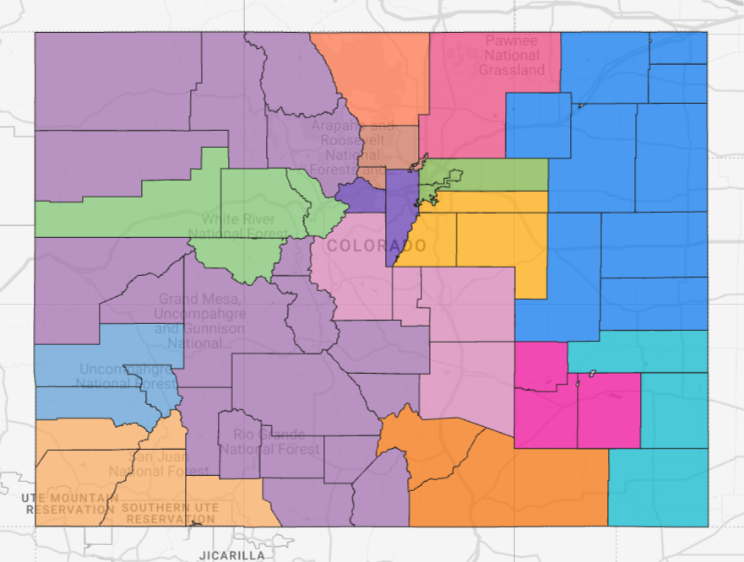
Where to apply?
Case Management Agency assigned to your county
www.familyvoicesco.org (303) 877-1747 info@familyvoicesco.org

Slide 25
HCBS Waiver Resources
Adult Waivers Chart
Children's Waivers Chart
Adult Waiver Flowchart
Children's Waiver Flowchart
Services Comparison Chart
Acronym Guide – English
More…
www.familyvoicesco.org (303) 877-1747 info@familyvoicesco.org

Slide 26
Buy in Program for Working Adults
Who qualifies?
You must be 16 year old or older
You must be employed (no minimum amount)
You must have a qualifying disability
Your income after disregards must be below 450% of the Federal Poverty Level (FPL). For example, you can earn about $11,020 a month and qualify. You may have additional income that is disregarded.
Gives access to “state plan” Medicaid or can be used to meet the financial requirements for any Medicaid HCBS waiver
https://hcpf.colorado.gov/buy-in-program-working-adults-disabilities

Slide 27
How to apply?
 | MAGI | Buy-in | HCBS Waivers
Medicaid Application www.colorado.gov/peak or County Department of Human Services | ✅ | ✅ | ✅
Disability Determination County Department of Human Services - Application goes to ARG/Arbor for review or Social Security Administration |  | ✅ | ✅
Level of Care and Waiver Application Case Management Agency |  |  | ✅
SSI
Financial and disability eligibility are done through the Social Security Administration County Department of Human Services “activates” Medicaid based on info from SSA

Slide 28
How to renew?
 | Programs | Frequency
Medicaid Application www.colorado.gov/peak or County Department of Human Services | MAGI, Buy-in, Waivers | Annually
Disability Determination County Department of Human Services - Application goes to ARG/Arbor for review or Social Security Administration | Buy-in, Waivers | Every 5-7 years - on “diary date”
Level of Care and Waiver Application Case Management Agency | Waivers | Annually

Slide 29
Creative/Complex Solutions
Creative Solutions (children) and Complex Solutions (adults) were developed by Health Care Policy and Financing (HCPF) to bring all funders and programs into a cohesive group to assist members and their families who may be in crisis.
Creative/Complex Solutions can be requested by anyone - the family, provider, advocates or systems like child welfare agencies or the Community Centered Boards or Case Management agencies.
Meeting facilitated by Regional Accountable Entity (RAE)
Directory of RAEs

Slide 30
Creative/Complex Solutions
Individual must be on Medicaid (no waiver required)
For individuals with dual diagnosis of Mental Health and Developmental Disabilities
An Interdisciplinary Team Staffing Call should be conducted prior to escalating to creative solutions
Those involved in the member’s care come together to discuss care coordination efforts, ensure there is no duplication of efforts, and work together to best meet the member’s needs
To request a Creative Solutions call:
Contact your RAE

Slide 31
Creative/Complex Solutions - Who Can Attend?
Care Manager from RAE
Case Manager from CMA
Parents
Advocate
Medicaid Staff
Current Treatment Team
GAL (Guardian Ad Litem)
Division Human Services
School District Staff
Anyone else involved in the member’s life/care

Slide 32
Creative Solutions - Outcomes
Goal: Manage current crisis and implement supports to avoid future crises
Potential outcomes of Creative Solutions calls
Increased collaboration between team members
Team decision helping with needs like in or out of state residential placement or treatment facilities, interim supports and services until a more permanent solution is put in place & school supports and placement

Slide 33
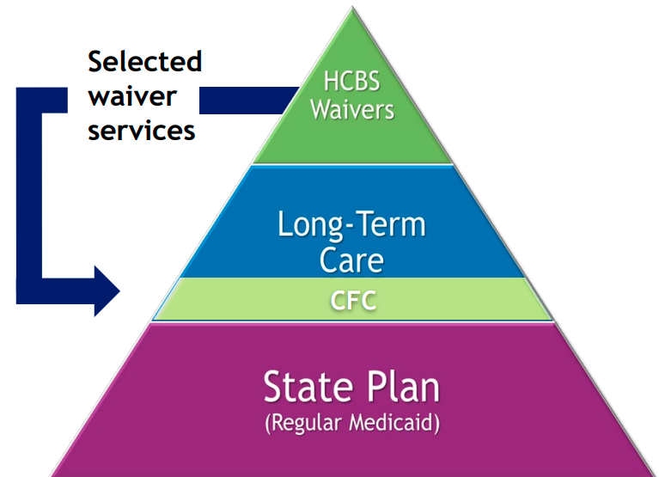
Upcoming Changes
Community First Choice (CFC)
Transition some services from HCBS waivers to be available to any Medicaid member who meets the level of care needs regardless of how they access Medicaid
Services transitioning are still being finalized, the biggest impact will be expansion of IHSS and CDASS
July 1, 2025 start date
https://hcpf.colorado.gov/community-first-choice-option
www.familyvoicesco.org (303) 877-1747 info@familyvoicesco.org

Slide 34
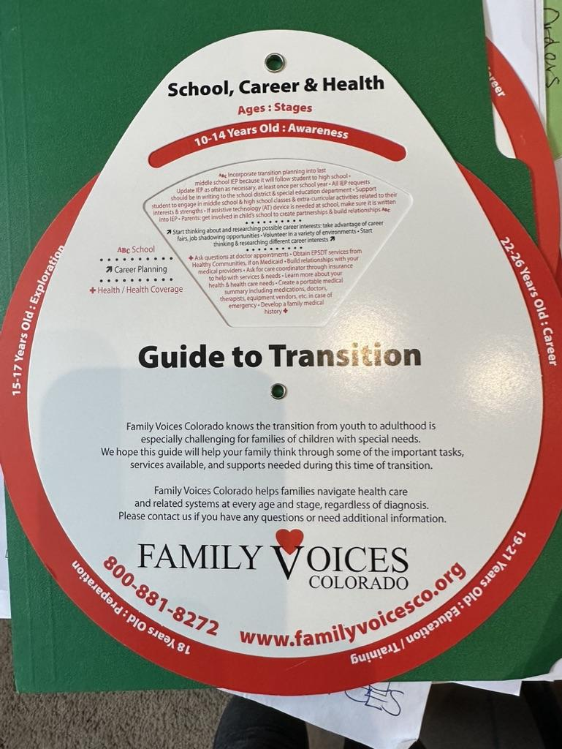
Transition Wheel
https://www.familyvoicesco.org/life-stages-transition
Transition Checklist

Slide 35
Questions?
Contact:
Main number (303) 877-1747
Megan Bowser - Executive Director
megan@familyvoicesco.org
Brenda Delgado - Bilingual Family Navigator
brenda@familyvoicesco.org
Jamie Stefanski - Family Navigator - Transition Specialist
jamie@familyvoicesco.org

