Slide 1
Early Periodic
Screening Diagnostic and Treatment(EPSDT)
www.familyvoicesco.org (303) 877-1747 info@familyvoicesco.org

Slide 2
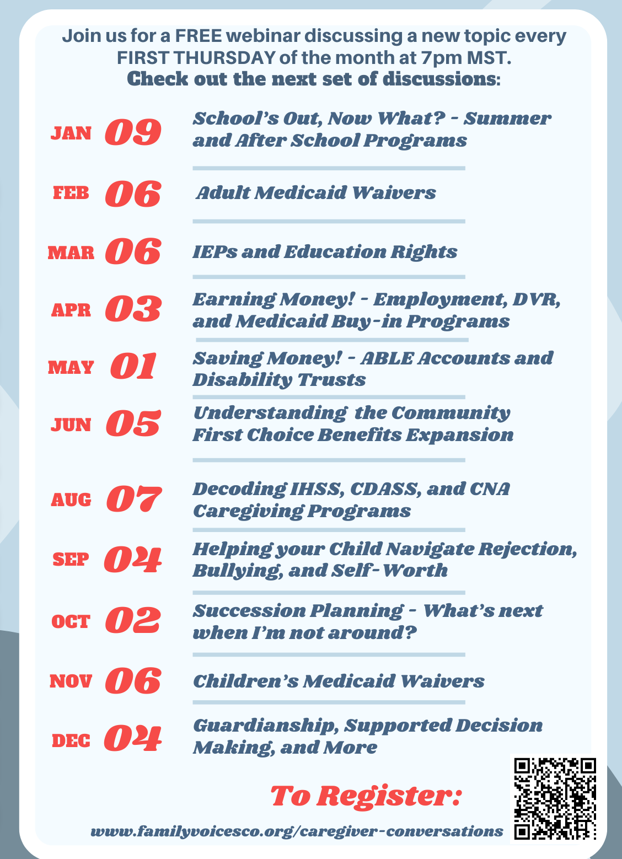
Caregiver Conversations
Webinars on the first Thursday of every month.
7:00 PM-8:30 PM
NOTE: Please do not share private health information, as we are recording this webinar. If you have questions that are of a more private nature, one of our staff will connect with you, at another time.
info@familyvoicesco.org 303-877-1747

Slide 3
Welcome
Objectives
To understand Health First Colorado EPSDT’s benefits and policies when serving members aged birth up to their 21st birthday.
To utilize case studies to demonstrate ways EPSDT can be implemented to provide care to children 0-21.
To understand how to initiate EPSDT benefits.
Understanding HCBS waiver benefits versus EPSDT

Slide 4
EPSDT
Early: Assessing and identifying concerns early
Periodic: Checking children's health at periodic, age-appropriate intervals https://downloads.aap.org/AAP/PDF/periodicity_schedule.pdf
Screening: Providing physical, mental, developmental, dental, hearing, vision, and other screening tests to detect potential problems
Diagnostic: Performing diagnostic tests to follow up when a risk is identified, and
Treatment: Control, correct or ameliorate health problems found.

Slide 5
EPSDT Definitions and Resources
Best Practices for Adhering to Early and Periodic Screening, Diagnostic, and Treatment (EPSDT) Requirements - September 2024
HCPF EPSDT Fact Sheet - January 2024
Colorado EPSDT Website
Colorado EPSDT Rules and Regulations (8.280 - pg 82)

Slide 6
Early and Periodic Screening, Diagnostic and Treatment
EPSDT is a federal mandate for preventive and comprehensive health for most Medicaid-eligible individuals under the age of 21 for most any state that accepts federal funding.
EPSDT provides infants, children, and adolescents with access to comprehensive, periodic evaluations of health, development, and nutritional status, as well as vision, hearing, mental health and dental services.
Notes:
Gina

Slide 7
EPSDT IS MEDICAID
There is no separate eligibility
There is no application
There is no special bucket of money
There is no separate release of information form
Notes:
As with the CMS regions, services vary state to states due to the ability to decide whats in the state plans. While EPSDT should apply some consistency across states, its also open to interpretation.

Slide 8
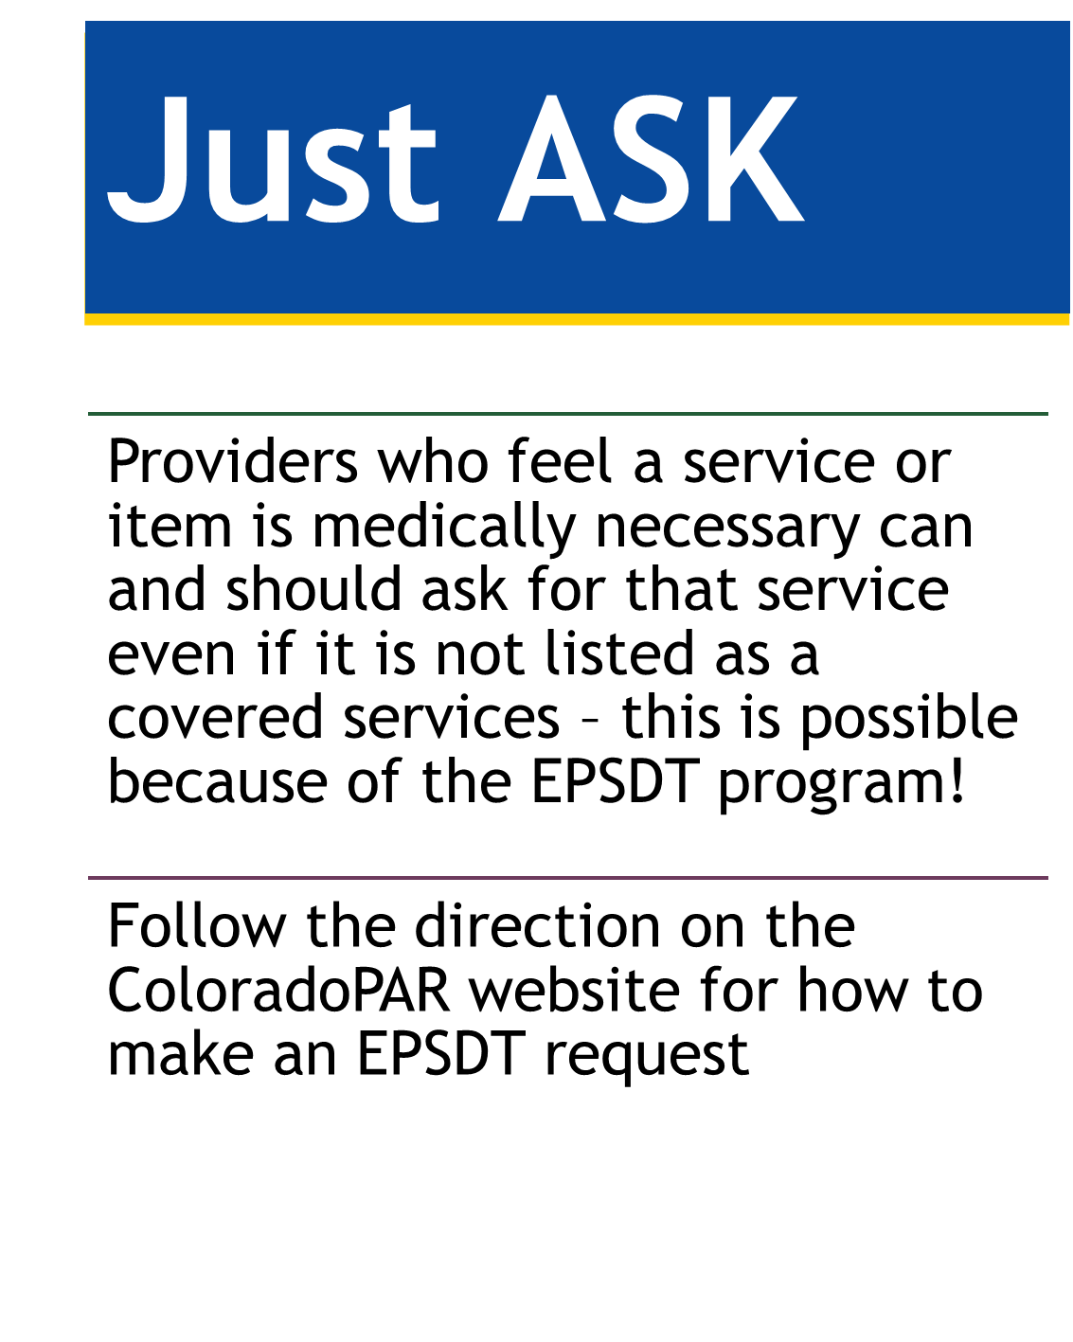
https://www.colorado.gov/pacific/hcpf/early-and-periodic-screening-diagnostic-and treatment-epsdt

Slide 9
Fee for Service and EPSDT
Fee For Service - State Plan Benefits
•Billed to Health First Colorado
•May have limits on amount or duration
•All services must be approved by legislature and contained in CMS regulations
•Wraps around RAE non-contracted services and benefits
•Has definition of medical necessity (8.076)
EPSDT
•EPSDT is a mandatory part of the Medicaid program
•Not a separate checkbook – no services paid under this program or billed to this program - billed to Health First Colorado
•Removes limits on amount or duration in fee for service benefits
•Wraps around RAE non-contracted services and benefits
•Allows any benefit to be requested even if not in the state plan
•Adds to the definition of medical necessity (8.280)

Slide 10
Case Study #1
A twelve-year-old has been violent with family members. The police have been involved multiple times with the child going to the hospital on a mental health hold. Child also meets the definition of Developmental Disability through an adaptive behavior score.
Notes:
Not prior to age 4 unless medical reason, looked t on case by case basis.

Slide 11
Case Study #1
Initiate a Creative Solution call related to the twelve- year-old’s mental health and IDD diagnosis. Ensure everyone who is working with the child is invited, including: CMA(CCB), school district, special ed, juvenile justice, therapists, the hospitals.
Regional Accountable Entity(RAE) Facilitates these calls:
Case by case basis – everything is on the table by request

Slide 12
Care Meetings or Creative Solutions Meetings
For children with dual diagnosis
(Mental Health and Developmental Disabilities)
https://hcpf.colorado.gov/sites/hcpf/files/EPSDT%20Screening%20Referral%20Form%20Sept%202019.pdf
RAE’s may send the CMA an invite to talk about a member with specialized needs.
Other invitees could include:
Parents
HCPF Staff
Current Treatment Team
GAL
Division Human Services
School District Staff
Notes:
These meetings - sometimes called Creative Solutions meetings, Care Team Meetings, Red Team meetings many other options are to bring all of the program staff into a single meeting with the parent/guardian to help locate and pay for services that may be needed. Other programs could include Momentum/TSP or Mill Levy programs and services.

Slide 13
...Or Are Services Not Available In State
EPSDT may be able to cover out of state treatment for some children and youth with specialized needs.
Required for each EPSDT request:
EPSDT Request Form
Basic care plan from requesting facility
Cost breakdown from requesting facility
A recent list of all denials from appropriate in state providers
A referral for the services from a medical provider
RAE denial showing denial reason
Current clinicals
Payment options for costs not covered - education costs?
Notes:
Why RAE denial? To see if you are following EPSDT – case recently denied by computer based on dx that was 11 years old and ruled out several times after that date – HCPF will push back on these denials if needed – denials need to be appropriate – don’t deny for medical necessity if it truly needs to wrap around to Fee for Service or EPSDT. The RAE is responsible for the case management for these services and they understand how to submit the packet for the exception process. Remember not everything needs out of state treatment and all in state providers must be exhausted prior to making a request.

Slide 14
Case Study #2
A 4-year-old with multiple disabilities needs a third pair of glasses, in less than a year, due to extreme wear and tear.
This Photo by Unknown Author is licensed under CC BY-NC-ND

Slide 15
Case Study #2
EPSDT has no hard limits for individuals 21 or younger. This child will receive new glasses.
No Hard Limits-on anything including therapies, no hard limits on anything that is medically necessary.

Slide 16
EPSDT and Medical Necessity
Medical necessity is state defined; there is no federal definition.
EPSDT entitles children to any treatment or procedure that fits within one of the categories of Medicaid-covered services listed in Section 1905(a) of the Act if that treatment or service is necessary to “correct or ameliorate” defects and physical and mental illnesses or conditions identified by screens.
“Maintenance” is a benefit under EPSDT
Medical necessity is defined: https://hcpf.colorado.gov/sites/hcpf/files/EPSDT%20Fact%20Sheet%20January%202024.pdf
Notes:
Gina

Slide 17
Limitations of Medicaid Services for Children
Permitted
Prohibited
Utilization Controls
Utilization controls, such as prior authorization for some services
× Prior authorization for screenings
× Using utilization controls that delay the provision of necessary treatment
× Service caps (“Hard limits”)
Experimental Treatment
While EPSDT does not require coverage of experimental services, a state may do so if it determines that treatment would address a child’s condition
Relying on the latest scientific evidence to inform coverage decisions
Cost Effective Alternatives
Considering cost when deciding to cover a medically necessary treatment or an alternative
Covering services in a cost effective way, permitted they are as good as or better than the alternative
× Denying treatment due to cost alone
Source: https://www.medicaid.gov/medicaid/benefits/downloads/epsdt_coverage_guide.pdf
Notes:
Cost -

Slide 18
Medical Necessity
It is a reasonable, appropriate, and effective method for meeting the client’s medical need;
The expected use is in accordance with current medical standards or practices (clinical guidelines exist);
It is cost effective; and
It provides for a safe environment or situation for the client
https://hcpf.colorado.gov/epsdt

Slide 19
Medical Necessity is NOT
Experimental or investigational
To enhance the personal comfort of the client
To provide convenience for the client or the client’s caretaker
To take the place of clinical guidelines or evidence-based medicine

Slide 20
Justifying Medical Necessity
Include the following information:
Full name of child, names of parents
Date of birth of child
Insurance plan name (there may be more than one plan)
Relevant diagnoses (codes are helpful only if they are accurate! Ask the doctor.)
Item/service being requested
Why the item/service is medically necessary

Slide 21
Justifying Medical Necessity
7. What positive/negative impacts the item/service will result in (include financial)
8. Scope and duration of treatment
9. Supplemental documents (pictures, letters from other providers, research articles, product information, Prior Authorization Request)
10. Include funding streams NOT able to help
(denial letters, etc.)
Family Voices CO can assist in writing Letters of Medical Necessity

Slide 22
Justifying Medical Necessity
Terms to use:
medically necessary
clinically based
promoting independence
preventing secondary disability
cost-effective
safety
Terms to avoid:
custodial
rehabilitate
developmental delay/disability
speech delay (without a diagnosis such as aphasia)
educational
caregiver convenience

Slide 23
A Letter of Medical Necessity
Ask if your Letter of Medical Necessity answers the following:
Is there a licensed provider stating in writing, the item/service is medically necessary?
Is this item/service not for caregiver convenience?
Is this item/service costs effective and if so have you explained how?
Is this item/service considered standard medical practice?
Have you explained how long and how often the item/service will be used.
Is this item/service right for the need of individual?

Slide 24
Just ASK
Providers who feel a service or item is medically necessary can and should ask for that service even if it is not listed as a covered services – this is possible because of the EPSDT program!
Providers can even ask to have a service provided at a different location and to a greater extent!
Follow the direction related to the service about how to make a request - ColoradoPAR website for how to make an EPSDT request for physical health services, DentaQuest for oral health care, etc.
Notes:
You need to know what is available and how - dont tell a provider of a family that inpatient substance abuse treatment is not available when it is - just not under the RAE contracts. Methadone vs suboxone. RTC/RCCF when the child is in the custody of the county. There are many systems that all have to look at EPSDT as an option for coverage, eQ Suites, DentaQuest, Magellan, RAE UM systems, etc.

Slide 25
DON’T FORGET
EPSDT covers ALL Medical AND:
Dentistry
Pharmacy
Vision
Behavioral Health

Slide 26
Home and Community Based Waiver Services (HCBS)
Adult Waivers
Elderly Blind & Disabled
Supported Living Services
Developmental Disability
Brain Injury
Community Mental Health
Complementary and Integrative Health
Children’s Waivers
Children Extensive Support
Children’s HCBS
Children with Life Limiting Illness
Children Habilitation Residential Program

Slide 27
Waiver Services and Items
HCBS Waiver services have already been approved under CMS as not being available in fee for service or EPSDT
Some new or “gray area” items may need an EPSDT denial prior to moving to the waiver for coverage
Notes:
Dept issued memo and guidance on what may or may not be covered under a waiver or that the provider needs to make a request for the service to the fee for service systems. Some may mean an email to the EPSDT email box for an auto denial. Weighted Blankets would be one where we know there are no studies on the use of the equipment so they are not medically necessary - waiver would be an option.

Slide 28
Benefits Pyramid
HCBS Waivers
Optional Benefits:
Waivers, participant-directed services, transition services
Mandatory Benefits:
Nursing facility services, home health
Benefits:
PACE, case management
Long-Term Care
Mandatory Benefits:
EPSDT, Inpatient and outpatient hospital services, physician services, laboratory and x-ray services, more…
Optional Benefits:
Prescription drugs, dental services
State Plan (Regular Medicaid & EPSDT)
Notes:
Next - lets take a look at the benefits pyramid, which you have seen in other areas and webinars. When we look at these services as pyramid we can see that State Plan is the most widespread level of services and generally covers the most people.
As you move higher in the pyramid the services become increasingly optional and support smaller, more specific populations with the most intensive needs.
Individuals receiving services at a higher level in the pyramid are also able to receive the benefits of the level or levels below them.
For instance an individual who is receiving services through an HCBS waiver is also able to receive services through the State Plan – as long as those services are not duplicative.

Slide 29
Case Study #3
The family’s private insurance covers 10 therapy visits per year. The family just got on the Medicaid Buy-In and want to know what limits they have on Medicaid, for PT, OT & Speech.
This Photo by Unknown Author is licensed under CC BY

Slide 30
Case Study #3
The family’s private insurance pays for the therapy for first 10 visits. Medicaid as secondary insurance, covers therapies after the first 10 as well as any copays, deductibles, and cost sharing owed on the first 10 visits
Medicaid (due to EPSDT) does not have hard limits on therapies for children until age 21.

Slide 31
Case Management Agencies and Regional Accountable Entities Roles
RAE
Connect members to a Primary Care Medical Provider (PCMP) to serve as their medical home
Provide Primary Care Case Management
Ensures coordinate services for physical and behavioral health needs
RAEs complement the work of CMAs
CMA
Eligibility determination for long-term services and supports (LTSS)
Service plan development and monitoring
Coordination of long-term services and supports
Coordinate- across disparate providers, social, educational, justice, and other community agencies
Notes:
Even tho not listed is child welfasre should be involved. Look around the table make sure school is present, CCB, County, all involved with kiddo!!

Slide 32
If Denied - Why Denied?
IF THE DENIAL IS FOR NOT BEING MEDICALLY NECESSARY, FOLLOW THE APPEAL PROCESS THROUGH THE RAE AND TO THE STATE ADMINISTRATIVE LAW JUDGE (ALJ)
IF THE DENIAL IS FOR NOT BEING A COVERED BENEFIT OR COVERED SERVICE, WRAP THE REQUEST AROUND TO HEALTH FIRST COLORADO AS A PAYER
Notes:
Why do you care about the reason something has been denied? So you can help the families with the correct process to appeal or help the provider wrap the services around under the Fee for Service or the EPSDT exception process. RAE denials for behavioral health also have access to the Ombuds for Managed Care for assistance with appeals and service levels like access or quality of care.

Slide 33
Reminder
Until age 21!
Even if an individual is in a “adult” program, such as a behavioral health program, they are still entitled to EPSDT, Including:
No Limits (caps)
Flexibility
Amount
Duration

Slide 34
Take Away
EPSDT:
No limits or hard caps in services are allowed even if the limits is in state rules
All services that could be provided under Medicaid regardless of whether they are covered in the state plan
EPSDT applies to all XIX eligibility categories for those 20 and under (not CHP+)
Case management and outreach required
Just ASK

Slide 35
Contacts
HCPF- EPSDT
Gina Robinson
303-866-6167
Gina Robinson gina.robinson@state.co.us
Family Voices Colorado
info@familyvoicesco.org
303-877-1747
Notes:
Please watch the underscroes needed in the addresses!

