Slide 1

Paid Caregiver Programs
www.familyvoicesco.org (303) 877-1747 info@familyvoicesco.org

Slide 2
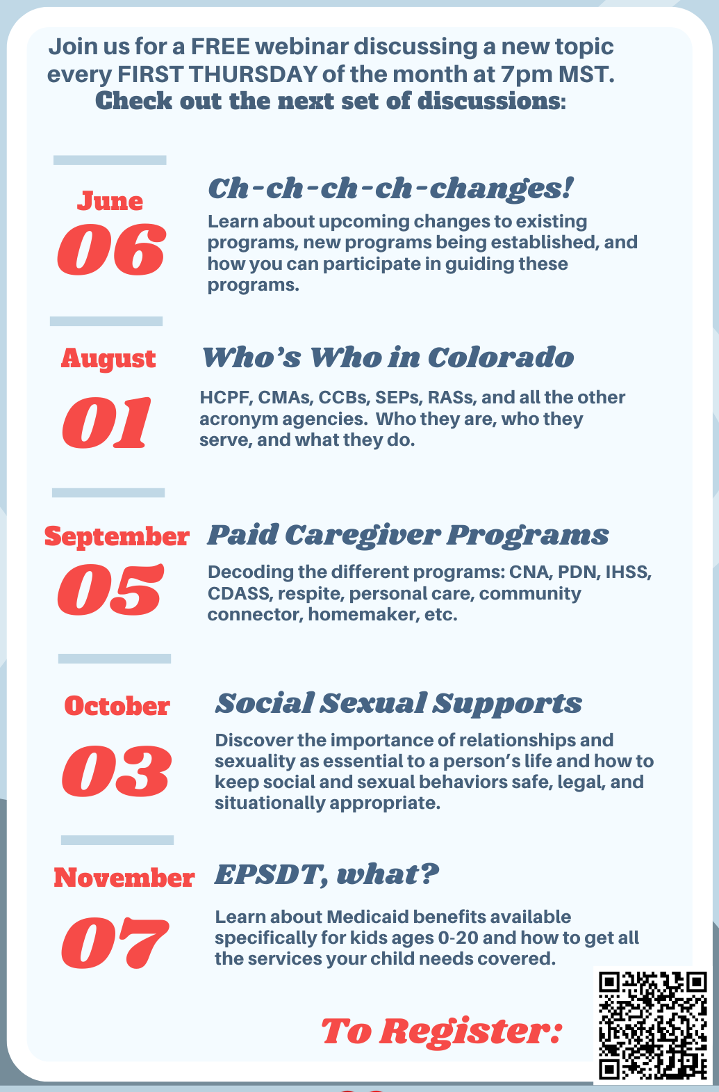
Caregiver Conversations
Webinars on the first Thursday of every month.
7:00 PM-8:30 PM
We know your time is precious we and are committed to providing information in a specific timeline.
Our timeline:
7:00-7:05 Intros and Overview
7:05-8:15 Information
8:15-8:30 Questions/Answers
NOTE: Please do not share private health information, as we are recording this webinar. If you have questions that are of a more private nature, one of our staff will connect with you, at another time.
info@familyvoicesco.org 303-877-1747

Slide 3
Definitions
CDASS - Consumer Directed Attendant Support Services
CNA - Certified Nursing Assistant
CMA - Case Management Agency
DD - Developmental Disabilities
EPSDT - Early, Periodic, Screening, Diagnostic, and Treatment
HCBS - Home and Community Based Services
HMA - Health Maintenance Activities
IHSS - In Home Support Services
LTC - Long Term Care
LPN - Licensed Practical Nurse
PAR - Prior Authorization Request
PAT - Pediatric Assessment Tool
PASA - Program Approved Service Agency
PCAT - (Pediatric) Personal Care Assessment Tool
PDN - Private Duty Nursing
RN - Registered Nurse

Slide 4
Medicaid - Health First Colorado
Benefits Pyramid
HCBS
Waivers
Waivers, participant-directed services,
transition services
Long-Term
Care
Nursing facility services, home health, case management
State Plan
(Regular Medicaid)
Inpatient and outpatient
hospital services, physician services, laboratory and x-ray services, prescription drugs, dental services, and more
www.familyvoicesco.org (303) 877-1747 info@familyvoicesco.org
‹#›

Slide 5
Private Duty Nursing and Intermittent Nursing
Funding - State Plan Medicaid benefit
Provider
  Licensed Professionals (RN or LPN)
  Employed by Home Healthcare Agency
  Can be parent or spouse
Skilled Care - Medical Model
Hours evaluated by home healthcare agency nurse and prescribed by doctor
  need PAR approval
  must be medically necessary
Private Duty Nursing (PDN)
Extended visits to provide near continuous care
Adults must be “technology dependent”
Intermittent Nursing
Short visits
Completing specific tasks

Slide 6
CNA and Pediatric Personal Care
Funding - State Plan Medicaid benefit
Hours evaluated by home healthcare agency nurse (using PAT or PCAT) and prescribed by doctor
  need PAR approval
  must be medically necessary
CNA
Provider
  Licensed Professionals (CNA)
  Employed by Home Healthcare Agency
  Can be parent or spouse
Skilled Care
  Medical Model
Short visits for specific tasks
Pediatric Personal Care (ages 0-21)
Provider
  Unlicensed
  Employed by Home Healthcare Agency
  Can NOT be parent or spouse
Unskilled Care
Short visits for specific tasks

Slide 7
CNA vs Personal Care Examples PAT
Skilled Care - CNA
Mouth Care: Mouth care for members who are unconscious, have difficulty swallowing or are at risk for choking and aspiration is considered skilled care. Mouth care is also skilled when a member has decreased oral sensitivity or hypersensitivity or when the member is on medications that increase the risk of dental problems or bleeding, injury or medical disease of the mouth. CNA may provide oral suctioning.
Bathing: The presence of open wound(s), stoma(s), broken skin and/or active chronic skin disorder(s); member is unable to maintain balance or to bear weight reliably due to fragility of illness, injury or disability, history of falls, temporary lack of mobility due to surgery or other exacerbation of illness, injury or disability.
Unskilled Care - Personal Care
Mouth Care: A personal care provider may assist and perform mouth care. This may include denture care and basic oral hygiene. The presence of gingivitis, receding gums, cavities and other general dental problems do not make mouth care skilled.
Bathing: Bathing is considered a personal care task when a member needs assistance with bathing, when the skin is unbroken and/or the member is independent with assistive devices.

Slide 8
Participant Directed Programs
Funding - Medicaid Waiver benefit
Provider
  Nurse Practice Act is waived - no license required
  Can be parent or spouse
Skilled and Unskilled Care services
  Health Maintenance Activities - HMA (skilled)
  Homemaker (unskilled) - ADULTS ONLY
  Personal Care (unskilled) - ADULTS ONLY
Hours/Budget evaluated by case manager using a task worksheet
IHSS -
CHCBS, EBD, and CIH waivers
Employed by Home Healthcare Agency
Agency required to provide backup coverage
Predetermined Medicaid reimbursement rates
Hours set based on case manager evaluation
Authorized Rep cannot provide care
CDASS - ADULTS ONLY
BI, CMHS, CIH, EBD, and SLS Waivers
Employed by Medicaid member
Member responsible for coordinating backup care
Budget set based on case manager evaluation
Member has flexibility to set hours and rates based on need within budgeted amount
Authorized Rep cannot provide care

Slide 9

Participant Directed Services
Homemaker (unskilled) - ADULTS ONLY
Routine housekeeping such as: dusting, vacuuming, mopping, and cleaning bathroom and kitchen areas;
Meal preparation;
Dishwashing;
Bed making;
Laundry;
Shopping for necessary items to meet basic
household needs.

Slide 10
Participant Directed Services cont.
Health Maintenance Activities - HMA (skilled)
Eating/Feeding
Respiratory Care
Skin Care
Bladder/Bowel Care
Personal Hygiene (bathing, shaving, haircare, nail care, oral care)
Dressing
Transfering
Mobility
Positioning
Medication Assistance
Accompaniment
Exercise
Personal Care (unskilled) - ADULTS ONLY
Eating/Feeding
Respiratory Care
Preventative Skin Care
Bladder/Bowel Care
Personal Hygiene (bathing, grooming, shaving, haircare, nail care, oral care)
Dressing
Transfering
Mobility
Positioning
Medication Reminders
Accompaniment
Protective Oversight

Slide 11
HMA vs Personal Care HMA Guide
Interventions are beyond what is age-appropriate, and abilities are outside of developmental norms
MOUTH CARE -
☐ Performed in conjunction with health maintenance level skin care
☐ Injury or disease of the face, mouth, head, or neck
☐ Presence of communicable disease
☐ Oral suctioning is required
☐ Decreased oral sensitivity or hypersensitivity
☐ At risk for choking and aspiration
BATHING -
☐ Performed in conjunction with health maintenance level skin care
☐ Performed in conjunction with health maintenance level transfers
☐ Performed in conjunction with health maintenance level dressing Special Considerations
☐ Dx of Paralysis
☐ Combative behavior during bathing
☐ Presence of stoma
☐ Inability to communicate verbally, non-verbally, or through other means that water is too hot/cold
☐ Other medical care needs and equipment (such as tracheostomy or gastrostomy tubes) that must be managed during bathing

Slide 12
Other Waiver Services - Children
Funding - Medicaid Waiver benefit
Provider - Employed by PASA
Hours evaluated by case manager
Respite:
CES, CHRP, and CLLI Waivers
Can NOT be provided by parent
Skilled (CNA, RN/LPN, or “therapeutic”) or Unskilled
Limits vary depending on waiver
Community Connector
CES and CHRP Waivers
Can be provided by parent
Unskilled
Limited to 10 hours per week when provided by parent (additional hours can be provided by outside person)
Homemaker
- Enhanced and Basic
CES Waiver
Can be provided by parent
Unskilled
Limited to 10 hours per week when provided by parent (additional hours can be provided by outside person)
Enhanced - extraordinary cleaning or habilitative

Slide 13
Other Waiver Services - Adult
Funding - Medicaid Waiver benefit
Provider - Employed by PASA
Hours evaluated by case manager
Respite:
SLS, EBD, CIH, BI, or CMHS waivers
Can NOT be provided by parent
Unskilled
Limits vary depending on waiver
Supported Community Connections
DD and SLS waivers
Can be provided by parent
Unskilled
Homemaker
- Enhanced and Basic
CMHS, CIH, EBD, and SLS waivers
Can be provided by parent
Unskilled
Enhanced - extraordinary cleaning or habilitative

Slide 14
Other Waiver Services - Adult cont.
Funding - Medicaid Waiver benefit
Provider - Employed by PASA
Hours evaluated by case manager
Personal Care:
SLS, EBD, CIH, BI, or CMHS waivers
Can be provided by parent
Unskilled
Residential:
DD waiver
Can be provided by parent
Unskilled
Daily rate all inclusive of daily needs
Rate determined by SIS Level

Slide 15
Children’s Programs
Ages 0-18

Slide 16
Pediatric - Home Health or Agency Based
 | Eligible Programs | Skilled | Individual License Required | Allowed by Parent | Hours Evaluated By | Limits (remember EPSDT)
CNA | State Plan | ✓ CNA level of care | ✓ | ✓ | PAT - Home health agency nurse | 10.5hr/day
PDN | State Plan | ✓ RN or LPN level of care | ✓ | ✓ | Home health agency nurse | 24 hr/day
Intermittent Nursing | State Plan | ✓ | ✓ | ✓ | PAT - Home health agency nurse | 4 visits daily
Pediatric Personal Care | State Plan | 🗶 | 🗶 | 🗶 | PCAT - Home health agency nurse | 8.5hr/day

Slide 17
Pediatric - Participant Directed - IHSS
IHSS | Eligible Programs | Skilled | Individual License Required | Allowed by Parent | Hours Evaluated By | Limits
Health Maintenance Activities | CHCBS Waiver Only | ✓ CNA, RN, or LPN level of care | 🗶 | ✓ | Case Manager | 24 hr/day
HMA Guide
IHSS Calculator

Slide 18
Pediatric - Waiver Services
 | Eligible Programs | Skilled | Individual License Required | Allowed by Parent | Hours Evaluated By | Limits
Respite | CES, CHRP, CLLI waivers | ✓ or 🗶 | ✓ or 🗶 | 🗶 | Case Manager | Different limits for each waiver
Community Connector | CES, CHRP waivers | 🗶 | 🗶 | ✓ | Case Manager | Average of 10 hours per week when provided by parent
Homemaker - basic and enhanced | CES waiver | 🗶 | 🗶 | ✓ | Case Manager | Average of 10 hours per week when provided by parent

Slide 19
Adult Programs
Ages 18 and older

Slide 20
Adult - Home Health or Agency Based
 | Eligible Programs | Skilled | Individual License Required | Allowed by Parent or Spouse | Hours Evaluated By | Limits (remember EPSDT for ages 18-20)
CNA | State Plan with LTC | ✓ CNA level of care | ✓ | ✓ | Home health agency nurse
PDN | State Plan with LTC | ✓ RN or LPN level of care | ✓ | ✓ | Home health agency nurse | 23 hr/day
Int. Nursing | State Plan with LTC | ✓ | ✓ | ✓ | Home health agency nurse | 4 visits daily
Pediatric Personal Care | State Plan ONLY ages 18-20 | 🗶 | 🗶 | 🗶 | PCAT - Home health agency nurse | 8.5hr/day

Slide 21
Adult Participant Directed - IHSS
IHSS | Eligible Programs | Skilled | Individual License Required | Allowed by Parent or Spouse | Hours Evaluated By
Health Maintenance Activities | EBD or CIH Waivers | ✓ CNA, RN, or LPN level of care | 🗶 | ✓ | Case Manager
Personal Care | EBD or CIH Waivers | 🗶 | 🗶 | ✓ | Case Manager
Homemaker | EBD or CIH Waivers | 🗶 | 🗶 | ✓ | Case Manager
IHSS Calculator

Slide 22
Adult Participant Directed - CDASS
CDASS | Eligible Programs | Skilled | Individual License Required | Allowed by Parent or Spouse | Hours Evaluated By | Limits
Health Maintenance Activities | BI, CMHS, CIH, EBD, and SLS Waivers | ✓ CNA, RN, or LPN level of care | 🗶 | ✓ | Case Manager | Overall waiver budget limitations and CDASS monthly budget allocation
Personal Care | BI, CMHS, CIH, EBD, and SLS Waivers | 🗶 | 🗶 | ✓ | Case Manager
Homemaker | BI, CMHS, CIH, EBD, and SLS Waivers | 🗶 | 🗶 | ✓ | Case Manager
CDASS Task Worksheet Monthly Allocation Worksheet

Slide 23
Adult - Waiver Services
 | Eligible Programs | Skilled | Individual License Required | Allowed by Parent or Spouse | Hours Evaluated By
Respite | SLS, EBD, CIH, BI, or CMHS waivers | 🗶 | 🗶 | 🗶 | Case Manager
Supported Community Connections | DD and SLS waivers | 🗶 | 🗶 | ✓ | Case Manager
Homemaker - enhanced and basic | CMHS, CIH, EBD, and SLS waivers | 🗶 | 🗶 | ✓ | Case Manager
Personal Care | SLS, EBD, CIH, BI, or CMHS waivers | 🗶 | 🗶 | ✓ | Case Manager
Residential | DD waiver | 🗶 | 🗶 | ✓ | 24/7 - rate determined by SIS Level

Slide 24
Demonstrating
Need
Disability Related
Necessary
Reasonable
Appropriate (age and developmentally)
Skilled vs unskilled

Slide 25

Duplicative
“Members who receive services through the waiver are also eligible for all Health First Colorado covered services as long as they are not duplicative”
Duplicative - same service at the same time
(ex. respite billing for feeding dinner and CNA billing for feeding dinner)
DD Waiver
residential rate covers all ADLs and
homemaker 24hrs a day, 7 days a week
CNA, HMA, personal care, homemaker,
respite would all be duplicative of residential

Slide 26


Pros and Cons of Parent Provided
Pros
Financial Stability
Dependability
Ease of Training
Love!
Cons
Isolation
Burn Out
Less Independent
Fewer Perspectives

Slide 27
Community First Choice
Upcoming Changes
DRAFT PLAN
- details are not finalized!

Slide 28
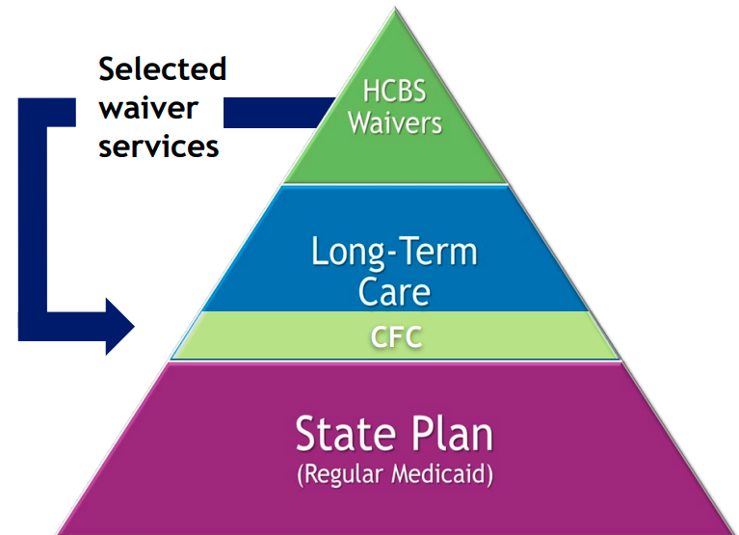
Upcoming Changes cont.
Community First Choice (CFC)
Transition some services from HCBS waivers to be available to any Medicaid member who meets the level of care needs regardless of how they access Medicaid
Services transitioning:
  Personal Care
  Homemaker (basic and habilitative)
  Health Maintenance Activities
  Acquisition, Maintenance, and Enhancement
of Skills (AME)
  Personal Emergency Response Systems and
Medication Reminders
  Transition Setup
  Home Delivered Meals
  Remote Supports and Remote Supports Technology
Will roll out 7/1/2025 - 6/30/2026
https://hcpf.colorado.gov/community-first-choice-option

Slide 29
Children’s Programs
Ages 0-18

Slide 30
Pediatric - Home Health or Agency Based
Proposed Changes
 | Eligible Programs | Skilled | Individual License Required | Allowed by Parent | Hours Evaluated By | Limits (remember EPSDT) | Difficulty of Care Eligible
CNA | State Plan | ✓ CNA level of care | ✓ | ✓ | Skilled Nurse Assessor | 10.5hr/day | only if CNA recipient is on a waiver
PDN | State Plan | ✓ RN or LPN level of care | ✓ | ✓ | Skilled Nurse Assessor | 24 hr/day | 🗶
Intermittent Nursing | State Plan | ✓ | ✓ | ✓ | Skilled Nurse Assessor | 4 visits daily | 🗶
Pediatric Personal Care | State Plan | 🗶 | 🗶 | 🗶 | PCAT - Home health agency nurse | 8.5hr/day | only if care provider lives with recipient
Draft

Slide 31
Pediatric - Participant Directed IHSS
Proposed Changes
IHSS | Eligible Programs | Skilled | Individual License Required | Allowed by Parent | Hours Evaluated By | Difficulty of Care Eligible
Health Maintenance Activities | State Plan with CFC | ✓ CNA, RN, or LPN level of care | 🗶 | ✓ | Skilled Nurse Assessor | Yes, assuming HCPF gets IRS approval, if care provider lives with recipient
Personal Care | State Plan with CFC | 🗶 | 🗶 | ✓ | Case Manager
Homemaker | State Plan with CFC | 🗶 | 🗶 | ✓ | Case Manager
Draft
HMA Guide IHSS Calculator

Slide 32
Pediatric - Participant Directed - CDASS
Proposed Changes
CDASS | Eligible Programs | Skilled | Individual License Required | Allowed by Parent | Hours Evaluated By | Difficulty of Care Eligible
Health Maintenance Activities | State Plan with CFC | ✓ CNA, RN, or LPN level of care | 🗶 | ✓ | Skilled Nurse Assessor | Yes, assuming HCPF gets IRS approval, if care provider lives with recipient
Personal Care | State Plan with CFC | 🗶 | 🗶 | ✓ | Case Manager
Homemaker | State Plan with CFC | 🗶 | 🗶 | ✓ | Case Manager
Draft
CDASS Task Worksheet Monthly Allocation Worksheet

Slide 33
Pediatric - Waiver Services
Proposed Changes
 | Eligible Programs | Skilled | Individual License Required | Allowed by Parent | Hours Evaluated By | Limits | Difficulty of Care Eligible
Respite | CES, CHRP, CLLI waivers | ✓ or 🗶 | ✓ or 🗶 | 🗶 | Case Manager | Different limits for each waiver | Only if care provider lives with recipient
Community Connector | CES, CHRP waivers | 🗶 | 🗶 | ✓ | Case Manager | Average of 10 hours per week when provided by parent | Yes, if care provider lives with recipient
Homemaker - extraordinary cleaning | CES waiver | 🗶 | 🗶 | ✓ | Case Manager | Average of 10 hours per week when provided by parent | Yes, if care provider lives with recipient
Draft

Slide 34
Adult Programs
Ages 18 and older

Slide 35
Adult - Home Health or Agency Based
Proposed Changes
 | Eligible Programs | Skilled | Individual License Required | Allowed by Parent or Spouse | Hours Evaluated By | Limits (remember EPSDT for ages 18-20)
CNA | State Plan with LTC | ✓ CNA level of care | ✓ | ✓ | Skilled Nurse Assessor
PDN | State Plan with LTC | ✓ RN or LPN level of care | ✓ | ✓ | Skilled Nurse Assessor | 23 hr/day
Int. Nursing | State Plan with LTC | ✓ | ✓ | ✓ | Skilled Nurse Assessor
Pediatric Personal Care | State Plan ONLY ages 18-20 | 🗶 | 🗶 | 🗶 | PCAT - Home health agency nurse | 8.5hr/day
Draft

Slide 36
Adult Participant Directed - IHSS
Proposed Changes
IHSS | Eligible Programs | Skilled | Individual License Required | Allowed by Parent or Spouse | Hours Evaluated By
Health Maintenance Activities | State Plan with CFC | ✓ CNA, RN, or LPN level of care | 🗶 | ✓ | Skilled Nurse Assessor
Personal Care | State Plan with CFC | 🗶 | 🗶 | ✓ | Case Manager
Homemaker | State Plan with CFC | 🗶 | 🗶 | ✓ | Case Manager
Draft
IHSS Calculator

Slide 37
Adult Participant Directed - CDASS
Proposed Changes
CDASS | Eligible Programs | Skilled | Individual License Required | Allowed by Parent or Spouse | Hours Evaluated By | Limits
Health Maintenance Activities | State Plan with CFC | ✓ CNA, RN, or LPN level of care | 🗶 | ✓ | Skilled Nurse Assessor | Overall waiver budget limitations and CDASS monthly budget allocation
Personal Care | State Plan with CFC | 🗶 | 🗶 | ✓ | Case Manager
Homemaker | State Plan with CFC | 🗶 | 🗶 | ✓ | Case Manager
Draft
CDASS Task Worksheet Monthly Allocation Worksheet

Slide 38
Adult - Waiver Services
Proposed Changes
 | Eligible Programs | Skilled | Individual License Required | Allowed by Parent or Spouse | Hours Evaluated By
Respite | SLS, EBD, CIH, BI, or CMHS waivers | 🗶 | 🗶 | 🗶 | Case Manager
Supported Community Connections | DD and SLS waivers | 🗶 | 🗶 | ✓ | Case Manager
Homemaker - extraordinary cleaning | CMHS, CIH, EBD, and SLS waivers | 🗶 | 🗶 | ✓ | Case Manager
Personal Care | SLS, EBD, CIH, BI, or CMHS waivers | 🗶 | 🗶 | ✓ | Case Manager
Residential | DD waiver | 🗶 | 🗶 | ✓ | 24/7 - rate determined by TBD… SIS Level
Draft

Slide 39
Questions?
Contact:
(303) 877-1747
info@familyvoicesco.org

