Slide 1
Medicaid and Assets; Special Needs Trusts, Pooled Trusts, ABLE Accounts, Financial Roles as your child ages
Megan Brand, Executive Director
CFPD-Colorado Fund for People with Disabilities

Slide 2
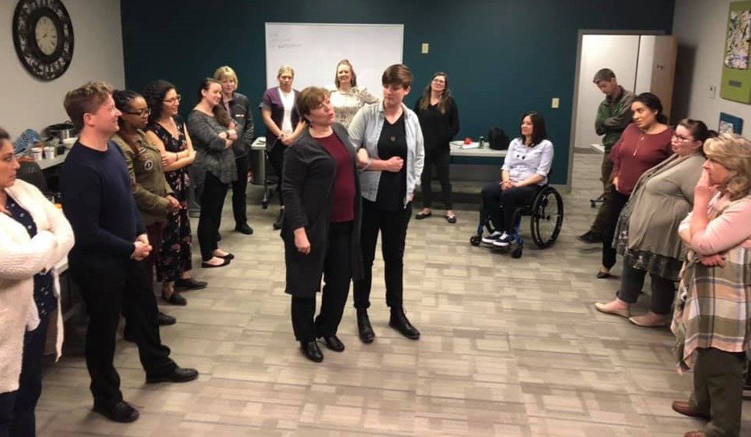
Established in 1994, CFPD is the largest and longest-standing locally managed pooled trust in Colorado. CFPD now provides a myriad of fiduciary services that offer protection, personalized attention, access to our network of organizations and services, financial guidance and someone on your side.

Slide 3
Our Services
 | Supplemental Needs Trusts (Pooled and Individual) A way to set aside some extra money and still qualify for Social Security and Medicaid benefits
 | Conservatorships Court-ordered money management with compassion
 | Case Management Services Expert guidance on an as-needed basis
 | Representative Payee Bills paid accurately and on time Mission Supports Connection to services for Denver residents with Intellectual/Developmental Disabilities who are experiencing homelessness

Slide 4
People we serve
Live across the state of Colorado
Are of every age
Cross-disability
Protecting very important benefits
By a staff of 26
….one person at a time

Slide 5
CO Medicaid Waiver Programs
Medicaid Waiver Programs -for Children under the age of 18.
Children HCBS Waiver (CHCBS)
Children Extensive Support Waiver (CES)
Children Habilitation Residential Program Waiver (CHRP)
Children with Life-Limiting Illness Wavier (CLLI)
Medicaid Waiver Programs -Individuals 18 Years of Age or Older (HCBS)
Persons with Brain Injury (BI)*
Community Mental Health Supports (CMHS)*
Elderly Blind and Disabled Waiver (EBD)*
Complementary and Integrative Health Waiver (CIH)*
Supported Living Services Waiver (SLS)*
Persons with Developmental Disabilities Waiver (DD) – Long wait list
(* Consumer-Directed Attendant Support Services (CDASS) is available)

Slide 6
Medicaid Deeming of Assets
Most Waiver programs for children do not count parent’s income or assets to the child.
A child may have assets due to an inheritance or a personal injury settlement that will disqualify the child for a waiver program.
A child can receive SSI benefits. For SSI, parents assets are deemed to child. Once child turns 18, parents assets are no longer counted.
For SSI purposes, child’s assets are not deemed to parent.

Slide 7
Medicaid Eligibility
Each of these programs have different qualification rules and are very state specific. For Medicaid Waivers or LTC:
Functional Assessment.
Income test $2,742 (2023) in Colorado.
Resource test - $2,000; $3,000 married couple.
Exempt assets – For the most part same as SSI exempt assets – Home, personal property, vehicle, term life insurance, irrevocable burial plan, wedding/engagement rings
Countable Assets: Bank accounts, retirement accounts, excess homes, land or vehicles, etc.

Slide 8
Why would someone need a trust?
People with disabilities who are on benefits such as SSI and Medicaid that have a Resource Limit.
People on benefits who wish to leave funds to a child impacted by disability.
People unable to personally handle any sums of money or may be vulnerable to exploitation
People who may receive benefits in the future

Slide 9
First Party Trusts
First Party Trusts are funded by Assets belonging to the Individual/beneficiary.
First Party Individual Trusts (Disability Trust or d(4)(a) trust)
Individual Trust Document is subject to Colorado Department of Health Care Policy and Financing (HCPF) approval.
Can be settled by the individual, court, parent, grandparent or guardian of beneficiary
Payback provisions on death or termination of trust (Depends on trust document)
Only permitted for those under the age of 65
First Party Pooled Trusts
Non-Profit must serve as trustee (Ex: CFPD)
Can be settled by the individual, court, parent, grandparent, or guardian of beneficiary
Master trust document—already approved by SSA and Medicaid
Allows for portability from state to state
A spending plan must be completed for individuals funding trusts age 65 and older.

Slide 10
First Party Trusts
Trust Oversight:
Individual trusts
Federally: 42 USC § 1396 (d)(4)(A)
Colorado: C.R.S. §15-14-412.8 and 10 CCR 2505-10 8.100.7.E.6.b
Individual Trust Document
Pooled trusts
Federally: 42 USC § 1396 (d)(4)(C)
Colorado: C.R.S. §15-14-412.9 and 10 CCR 2505-10 8.100.7.E.6.c
Master Pooled Trust Document

Slide 11
Third Party Trusts
Funded by assets belonging to ANYONE except for the beneficiary. (Typically, parent or grandparent)
Third Party Individual Trusts (also called Special/Supplemental Need Trust)
Drafted by an attorney as a stand-alone document or part of a Will.
No Medicaid payback provisions required.
More flexibility, especially in movement among states.
Third Party Pooled Trust
No Medicaid payback provisions
Master trust document—already approved by SSA and Medicaid
Allows for portability from state to state

Slide 12
Third Party Trusts
Trust Oversight:
Individual trusts
Federally: POMS SI 01120.200
Colorado: C.R.S. §15-14-412.8 and 10 CCR 2505-10 8.100.7.E.6.d
Individual Trust Document
Pooled trusts
Federally: POMS SI 01120.200
Colorado: 10 CCR 2505-10 8.100.7.E.6.d
Master Pooled Trust Document

Slide 13
Special Needs Trust Comparison
 | Individual (First Party) Private Trust 42 USC § 1396p(d)(4)(A) C.R.S. § 15-14-412.8 | Pooled (First Party) Trust 42 U.S.C. §1396p(d)(4)(c) C.R.S. § 15-14-412.9 | Individual Third-Party Private Trust | Pooled (Third-Party) Trust
Administration | Family member, professional fiduciary, bank | Non-Profit organization | Family member, professional fiduciary, bank | Non-Profit organization
Age | Must be under 65 | No age restrictions per se, but at the age of 65 and over the Beneficiary must be reasonable able to spend down the funds in their expected lifetime. | Can Be of any age | Can be of any age
Transfer Penalty | None | Maybe under some circumstances for persons over age 65. None for persons under 65. | None | None
Annuities | Must name Medicaid as a beneficiary | Trust may be named as a beneficiary | Do not need to name Medicaid or trustee as a beneficiary | Do not need to name Medicaid or trust as a beneficiary
Definition of Disability | Must meet definition of disabled for the purposes of the SSI program | Must meet definition of disabled for the purposes of the SSI program | ADA definition is used | ADA definition is used
Distributions | Supplemental Needs for the Sole Benefit of the Beneficiary; notify CO Medicaid for those over $5,000 in new trusts. | Supplemental Needs for the Sole Benefit of the Beneficiary | Supplemental Needs for the Sole Benefit of the Beneficiary | Supplemental Needs for the Sole Benefit of the Beneficiary
Costs | Set up by private attorneys, cost varies. Administration costs vary | No attorney fees. Non-profit sets fees to establish and administer | Set up by private attorneys, cost varies. Administrative cost vary | No attorney fees. Non-profit sets fees to establish and administer
Remainder Interests (when Primary Beneficiary dies) | Medicaid must be paid first. Pro rata share among states | Will be paid back to the State Medicaid Agency to the extent it is not retained by the pooled trust. | A beneficiary can be named. (Medicaid has no claim on third-party funds) | A beneficiary can be named. (Medicaid has no claim on third-party funds)
Portability | Older trusts may need to be revised to comply with change in regulations to allow for pro rata share upon death. | Trust is for life. Can move to any state with similar law of pooled trusts or “ported” to new pooled trust. | Trust is for life. Can move to any state with similar law | Trust is for life. Can move to any state with similar law of pooled trusts or “ported” to new pooled trust.
Medicaid Approval | Must be approved by Medicaid in all non-SSI cases. | Master Trust pre-approved by Medicaid, but Medicaid must be notified. | Must be approved by Medicaid in all non-SSI cases. | Master Trust pre-approved by Medicaid, but Medicaid must be notified.
Social Security | Must approve all SSI cases. | Master Trust pre-approved by SSA, but SSA must be notified. | Must approve all SSI cases. | Master Trust pre-approved by SSA, but SSA must be notified.
Flexibility | Depends on document. | Streamlined process in place. | Depends on document. | Streamlined process in place.

Slide 14
What an SNT typically can’t pay for
Cash or cash equivalents cannot be given directly to the Beneficiary
Mortgage payment, rent payments (Counted as income if it is paid)
Utility bills, property taxes, homeowner or condo fees (unless property is held in Trust)
Food or groceries, eating out at restaurants, etc. (except while on a trip. )
Gambling, lottery tickets, gifts of any kind, pawned items or items that can be considered a resource
Third party benefit. This means payment for anything which primarily benefits someone other than the Beneficiary. An example would be gifts to family members.
Services or items for which the Beneficiary is entitled to receive payment through another program. An example is prescription medication that should be paid by Medicaid.
At the time of death, Distributions are not allowed or severely limited, depending on the trust document.

Slide 15
What an SNT can pay for

✈




RECREATION
MEDICAL CARE
(NOT COVERED BY BENEFITS)

👓

⬆
①
Vacations
Companionship Services
Entertainment
Subscriptions
Memberships
Pets
Cable TV
Dental Work
Glasses
Hearing Aids
Massage
Hair Care
Co-Pays
Personal Supplies
Vitamins/Supplements

Slide 16
What an SNT can pay for


①
✆

⬆
HOUSEHOLD
TRANSPORTATION

❖
✈
◆
✦
Home Purchase
Home Maintenance
Clothing
Telephone
Appliances
Furniture
Home Insurance
Accessibility Upgrades
Public Transportation
(Bus Passes, Light Rail, Etc.)
Vehicle Purchase
Vehicle Maintenance
Gasoline
Auto Insurance

Slide 17
What an SNT can pay for
EDUCATION
SERVICES
☞
⓪
🕆
Public/Private Education
Training
Computer
Software
Books
Vocational Training
Attorney Fees
Alternative Therapies
Guardian Fees
Conservator Fees
Burial Plan
🖳
◻

Slide 18
ABLE—A Better Life Experience
10 Quick Facts
A Better Life Experience (ABLE) was passed in the US Congress and signed into law Dec, 2014.
In CO, the enabling legislation was introduced by College Invest and passed in 2015.
ABLE is kin to 529 plans. It is 529a of the Internal Revenue Code.
ABLE is limited to people with disabilities who were disabled before the age of 26. However, they may contribute at any age.
Individuals with disabilities, their family and friends can contribute to ONE account for each individual.
Annual contributions (from all sources) are limited to the gift tax exclusion, currently $17,000 in 2023 or higher for those who are working. (Additional amount for those working is = Federal Poverty Limit)
The total value of the account cannot exceed $100,000 for SSI recipients (before suspension of SSI, not Medicaid) and lifetime contributions cannot exceed $500,000 in Colorado.
Distributions are different than SNT’s. They must be related to the individual’s blindness or disability. Allowable expenses: Education, *Housing, Transportation, employment training and support, assistive technology and personal support services, health, prevention and wellness, financial management and admin services, legal fees, expenses for oversight and monitoring, funeral and burial.
The account holder manages their own distributions. The administrator (like College Invest) has no discretion.
In Colorado, Medicaid is now prohibited from filing a claim on the funds upon the death of the beneficiary (as of January, 2023).
*Housing is one of the greatest benefits of ABLE Accounts and it is not the same for Trust.
“For many families, the ABLE account will be a significant and viable option in addition to, rather than instead of, a Trust program.” National Down Syndrome Society.

Slide 19
Fiduciary Roles and Responsibilities
FIDUCIARY | ESTABLISHMENT | AUTHORITY | DUTIES | REPORTING | TERMINATION | RELATIONSHIP
Representative Payee | Appointed by Social Security Administration | Handles ONLY Social Security money | Receives & Pays Out Social Security money | Annually to SSA on their form which they send by mail | Death of Beneficiary, resignation or revocation by Social Security Administration | Accountable to Social Security Administration
Agent under Power of Attorney | Appointed by Principal | As described by document | As described by document | As described by document, usually to Principal & family | Death of Principal, resignation or revocation by Principal or Court | Accountable to Principal (and maybe family and/or court) CANNOT override Principal
Trustee | Appointed by Settlor | Handles all Trust transactions and assets | Receives Trust assets and makes payments or disbursements as prescribed by Trust | To settlor and beneficiaries and any other party named by Trust | As described by document, resignation or removal | Accountable to Trust Beneficiaries
Guardian | Appointed by Court | Makes decisions regarding the person, i.e., medical care, housing | Responsible for making decisions regarding medical care, housing, treatment, services, etc. regarding the person | Annual court reports | Death of Incapacitated Person, revocation by court or resignation (but must act until successor is appointed) | Can override incapacitated person
Conservator | Appointed by Court | Handles personal finances | Receives, pays out, invests funds belonging to the person | Annual court reports | Death of Protected Person, revocation by court, or resignation (but must act until successor is appointed) | Protected Person CANNOT handle money other than permitted by Conservator

Slide 20
Questions?
Megan Brand
Executive Director
www.cfpdtrust.org
mbrand@cfpdtrust.org
(303) 733-2867
CFPD’s Mission: We serve people with disabilities and older adults by providing fiduciary services and navigation of public benefits and other resources.
CFPD envisions a collaborative community that advocates for and empowers people with disabilities and older adults by creating individualized opportunities to enhance their quality of life.

